Slide 1
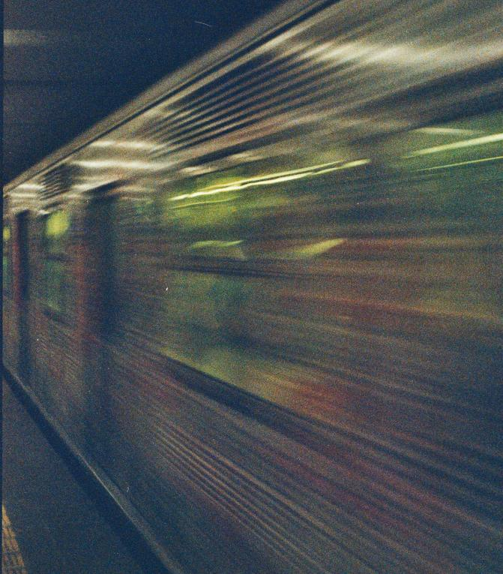

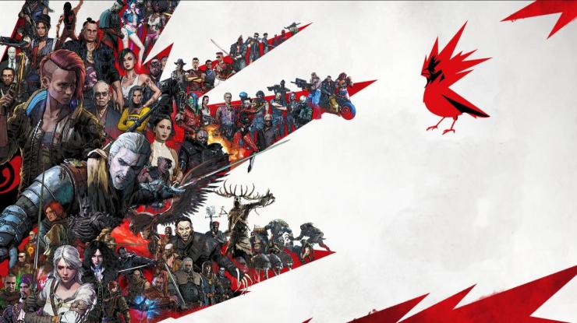

PROJECT-RED
PLAY

Slide 2




A.R_I18N
00054
WELCOME
ABOARD!
Greetings!
Team CD Projekt Red!
We are team Blaze, up with an idea for your upcoming project!
We believe that this project align with your distinctive immersiveness
and challenging Gaming Experiences.

Slide 3


A.R_I18N
00054
I am happy that you are ready to read My project; I respect every one.
As for the ppt we want every one to experience it so due to that there is no timer while using the slide show mode, you can change the slide by a click while using the slide show.
THANK YOU (Sorry for the inconvenience).

Slide 4
A.R_I18N
00054
WHY CD PROJEKT?
Specialty in Creativity
Immersiveness into fiction
Closest resemblance to reality

Slide 5
A.R_I18N
00054
CONCEPT OVERVIEW
Genre: Neo-Noir Action, Adventure
Setting : Futuristic city during the Second cold war in ending of 2080s .
Blends intense action sequences with character development and world-building

Slide 6
A.R_I18N
00054
KEY FEATURES
Character- driven narrative
Interactive elements
Moral ambiguity

Slide 7


A.R_I18N
00054
We hope that the story finds the best interest in your team and we apologize for
anything that feels offensive.
It’s not too late. Time to Buckle up!!

Slide 8


A.R_I18N
00054
Contents
1) Prologue - 8
2) Opening - 16
3) Apartment - 27
4) Office - 37
5) Prepping - 45
6) Work - 73
7) Conclusion - 87

Slide 9

A.R_I18N
TECHNOLOGY, FEAR AND BELIEF
00054
The ‘three things’ Humanity thought it could control
(a sigh)
[News Anchor reporting]
UN hosts meetings over Scrutiny and better utilization of resources in Stockholm. This improves the quality of life and make the world a better place with ‘AI’ to assist humanity...

Slide 10
A.R_I18N
00054
[Narrator)(As years are passing by...)
People fighting among themselves,
behaving like rogues,
just to get the deed done.
Faith is on the verge of defeat in these people.
Banged up and bruised to the core,
Life is becoming a struggle for all the basic needs..
(As the world is plunged into ‘chaos’).

Slide 11
A.R_I18N
00054
(Average news article in a newspaper)
This is the most historical moment to witness in the existence of mankind. And we are proud to witness it in 2066, as all the delegates from the UN Security Council are heading towards the Headquarters for signing a pact for decommission of nuclear weapons. Is this what the common folk wished for?....

Slide 12
A.R_I18N
00054
[News reporter continues )
And finally, the United States created its first humanoid, claiming that this improves the quality of life
(Life flickering to lie)
[News Anchor Reports]
“2069 marks the initiation of NeuraRun, A Japanese Corporation which unveiled their first ever Neural Shards in London this morning.”

Slide 13
A.R_I18N
00054
[AD 2072]
[Digital Newspaper Blipping]
“The Birth of Edge AI. Asian Subcontinents to lead charge.”
[2072 – 73]
“What is Edge AI?”
“AI v/s Humanoid. Which wins in this ultimate race of intelligence?”
[Best article written]

Slide 14
A.R_I18N
00054
[Average Digital Article on Mobile]
“UN suffers downfall due to lack of integrity. America to takeover UN?”
“Canada says ‘Yes!’, Joining the American Defense Front (ADF)”
[News Report on TV in a Restaurant]
“The Proletarian Union; which is the new Russian govt. to take over the east?”

Slide 15
A.R_I18N
00054
[AD 2081]
[Interview going live]
Reporter: “Front v/s Union. THE NUCLEAR ANNIHILATION. Is it going to happen for sure?”
(People Laughing)
Unknown (in a hilarious way): “I assure you, even if it is serious, that this will be an illusion, and it remains like one.”

Slide 16
A.R_I18N
00054
[Bunch of articles overlapping on each other]
“Net runners found dead in Norway under unexpected circumstances. No damage DETECTED ON THEIR BODIES, stated as per the report.”
“Sao Paolo facing Blackouts. ASSURANCE BY ADF FOR A BETTER SOLUTION.”
“Border or battlefield? Tensions escalating between India & Pakistan. ORDER GIVEN BY THE UNION TO STAND DOWN.”
“Guardian Angel saved Chancellor’s day. IS ONE BULLET ENOUGH TO SPARK A RIFE?”
“Polar caps melting, NOT TO TENSE, stated officials of both the governments.

Slide 17
A.R_I18N
00054
As the game opens, The protago checks his watch with time being “7:59:28-29.... and ticking” and as he turns back, The year ‘2089’ projects on to the horizon. Being bored, he puts on his head-set and listens to “take on me ”.
A man was bolting towards the car, opens the door and says, “Floor it, man!!” in a Russian accent. The protago, startled, floors the pedal to the metal and the player gets the control…
“What the fuck just happened there?”, a tense protago asks his Russian Man. “Nothing to worry” (x2) and a news about the shootout at a restaurant pops out of the radio. “You gonna tell me now?”, pointing towards the radio as the protago gets a bit worried.
“ Y’know, it’s the usual. Get in, grab the bucks, get out. BUT, this screwed up idiot spawned out of nowhere and started waving his gun.” “ FUCK.”(x3), the protago was worried about the situation and asks him, “Did you just fucking kill that guy?”
NOTE:-
Protago: Protagonist

Slide 18
A.R_I18N
00054
Showing the blood that smeared on his coat, the Russian takes it off, rolls it and throws it to the back of the car.
“Shit just got a whole lotta worse, man”, protago says in a tired manner. Russian adds, “Yeah, no shit.”
After some time cruising in the car,
(if fpp), a notification pops on the windshield, stating “Stop the car.”
(if tpp) it pops up on the screen.
NOTE: FPP (First person perspective)
TPP (Third Person Perspective)

Slide 19
A.R_I18N
00054
[Slowly perspective changes from 3rd person to 1st person]
A wing of police heli-carriers speeding towards the border. As the protago was about to start the car, “Hot Damn! That’s a beaut!”. As the bent cop knocks the glass, the protago rolls the glass down, “ Any problem bothering you, Officer?”. The officer, with some cunning looks in his face, voices out, “ That’s one damn vehicle you got there. You stole this ?”.
The protago states, “ It’s an antique and belonged to my old man. Got the papers if you want.”

Slide 20

A.R_I18N
00054
Spotting another guy inside the car, the Officer asks, “ Who is the other guy?”. The man stammers in a Russian Accent, “The other guy is his friend.” The Officer noticing the accent, calls his partner, “Hey, Steve! Look who’s here! A Rusky!!”. Steve continues, “Is it, Sir?”.
Steve showed up and questions, “How’s the Motherland? I heard she’s cold.” A tensed Russian says to the officer, “Well, everyone has a hard time, so guess it’s doing just fine.”

Slide 21
A.R_I18N
00054
The protago, who seems to be a bit worried, asks , “Any
Problem, Sir?”. The 1st officer replies, “ Why not show your ID first? We’ll decide about the problem.” The protago gets his ID from the dashboard and hands it over to the 1st officer while Steve frisks the Russian to the front.
The officer scans his ID and it shows as green. Even though his ID is verified, the officer had a questionnaire with him asking the protago . He asks in a deep voice, “ Do you think it’s needed, officer?” . The officer said, “ Are you high on dope or boozing like a drunkard? Just so you look like one.” “Nothing like that, officer. I have seen your folk on the boards. And I vouch that they’re naassttyy for business.” , in a charismatic way.

Slide 22
A.R_I18N
00054
While this goes on, The Russian was made to be flipped. Meanwhile, Natalie, the officer in-charge, shows up and yells at the 1st officer, “What the fuck are you doin’ here? There’s an explosion at the outskirts of the city and you’re filling your fuckin’ pockets?!!!”. The 1st officer stammers,
“Ma’am, these guys were…..”. She turned towards the ID, scans it and tells the protago, “Fuck off, NOW!!!”. She turned towards the patrollers and speaks to them like, “There’s an explosion and you’re trynna fill your fuckin’ pockets. Why?”

Slide 23
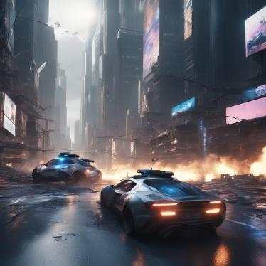
A.R_I18N
00054
As her voice fades, the protago and his chum are bailing out the street. The protago shows his face for the first time through the side-view mirror and a song plays, “What a wonderful World”
[they sing together]
[And the screen blacks out with the car door thudding….]

Slide 24
A.R_I18N
00054
The protago stops at an abandoned warehouse at the harbor. There were a few men waiting outside. The Russian insists the protago to tint the car.
While the protago tints the car, The Russian grabs the dope pack from the locker and as he gets out of the car,
The protago grabs his hand and pulls him back saying, “ You forgot sumthin’?”. The Russian, being tensed, thanks him for the heads up.

Slide 25
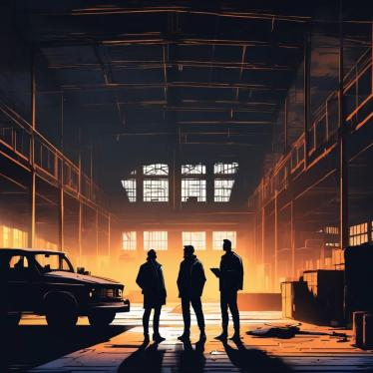
A.R_I18N
00054
The Russian goes to the men, while the protago is tapping his steering wheel, feeling anxious about his friend and the deal being held. Some other men are joining the deal making the Russian uncomfortable. “Shit. I think it’s about to go down.”, The protago feels as he tries to keep his hand in the dash for the gun.

Slide 26
A.R_I18N
00054
Meanwhile, the deal concludes and the Russian returns to the car. “Start the car.”, the Russian tells. As the protago starts the car, a guy shows up at the window and knocks on the glass. The protago rolls down the glass. He asks, “So you’re the new chum, huh?”. The protago tries to answer, however the Russian tells him, “The deal’s done, so we’re Leaving.” in a fierce manner.
Now as the two men cruise through the city, the protago glances at the billboards and looking at the ads. The Russian asks, “Why do you hate the ‘implants’? That’s the trend now. It’s helping a lot of lives out there, man.” The protago, with discomfort, speaks, “Those ‘implants’.. I… just I hate them; Every time I’ll get this kind of feeling, like pain and anger sifting through my mind at the same time.”

Slide 27

The Russian wonders as of why the protago speaks like that. So, he asks, “What has happened exactly?”. The protago, with a sigh of pain, replies, “The implants are why I lost everything. I’m losing my faith on them. I’m happy like this. Those things are not for me to be honest.”
The Russian tells the protago, “Pull over. I’ll drive.” He tells, “Why? Stats say that I’m better at driving” protago declares. “You’ve been driving for a long time. Just take a nap. I’ll get us back home in one piece. Scout’s honor.”, says the Russian as he gets down to take the wheel.
The protago is getting back to the seat while telling, “You better be…”. the protago keeps the jacket on the car’s floor and sleeps on the backseat, keeping his legs on the bloody seat.

Slide 28
A.R_I18N
00054
They go to their apartment. The Russian gets out of the car. He goes to the back, opening the door and wakes the protago up. “We’re here.”, says the Russian. “There’s nothing more special than HOME.” The protago gets out of the car and the Russian picks his jacket from the car. After they lock the car, they are moving towards the building. While they are entering the staircase, an old man shows up and yells at the duo, “Where is my Fucking rent, you motherfuckers?!!”. The protago says, “I’ll do it, old man. One more business day.”. As they go up, a young girl dressed up as a working girl, is waiting outside 222.

Slide 29
A.R_I18N
00054
The player has a choice. If he asks her, “What are you doing here? You live upstairs right?”.The girl replies, “Guests have come home. I’m just here to lighten their mood up.” The player has a choice whether to intervene or not. If he interferes, He says, “There’s a lot of better things to do in this life than this shit.” She says, “then who’s gonna pay the fucking bills? Your fucking dad?”

Slide 30
A.R_I18N
00054
The player has a choice whether to scold her and leave or give her some bucks and tells, “This’ll pay” while the guest gets out of the room and asks, “So even they’re having bodyguards now, huh?” , continues, “It’ll take some time for my company to join me. Think you can stand me until then?”
The protago slams the door at his face, breaking his nose. As the pervert falls down onto the floor, the girl laughs and goes upstairs to her flat. The player has a choice to loot the pervert’s money.
After that, he goes upstairs to his room 323.

Slide 31
A.R_I18N
00054
[choice]
Adjacent to his room, A small girl is playing outside with a toy. The player has a choice whether he can talk to the little girl or just go to his flat.
The protago puts his hand on the girl, asking her, “Why’s my Little Suzy outside?” The girl responds, “Nothing, Mike”. The protago asks, “Are they at it again?”. The girl nods with a sad face. Then the protago gives the little girl a candy bar and asks whether “CHRISTY” is inside or not. The girl responds, “Ya, mike. Mom’s not letting him outside.” in a sad tone. She asks him innocently, “Can you keep George and CHRISTY tonight?”

Slide 32
A.R_I18N
00054
The protago replies, “Not today, kiddo. Vasily’s got a headache. But you can stay if mom doesn’t let you in.”
Vasily, the Russian arrives upstairs and listens to their conversation and asks, “Suzy! You comin’ tonight?” and she tells. “Yes, Sarge!! I’m in!” and the trio go to the protago’s flat.
As they get into the flat, Suzy tells the protago that she’s going to watch the television. The protago tells her to keep the volume low. Vasily tells the protago, “Keep an eye on her. I’ll go freshen up.” “Yeah”.

Slide 33
A.R_I18N
00054
The player has optional stuff to complete like throwing Vasily’s shirt into the Washer. The protago asks the girl, “Do you want to eat something?” “Ya, I wanna have some rice. Do you have it, Mike?” The protago tells her, “It’ll be ready in a few minutes, Suzy”. The player takes out rice from the packet and closes it, adds spices and while the rice is cooking, the player goes into his room and hides the guns in a drawer and money in a locker.
As the cooker starts buzzing, the player can get into the kitchen. IF NOT, the rice gets overcooked and is inedible
(and fails the objective).

Slide 34
A.R_I18N
00054
The player serves the rice to the girl as Vasily freshened up. He asks, “How’s the school, Suzy?” “School’s fine. But I got a B+ in PE and I’m not showing this to my mom. So can you sign for me?”. The duo looks at each other and wonder why she’s worrying over the “B+”. “I will. But tomorrow morning.” “So, I heard that you were bullied, Suzy. Who was he?”, the protago asks her. “His name’s ‘Rad’. He used to bully me but I heard their family was threatened.” Vasily gets the rice bowl to serve Suzy. “I hate bullies. I never liked them”, says Vasily. They laugh at the joke while the protago focuses on the program that the girl’s watching.

Slide 35
A.R_I18N
00054
There were multiple knocks on the door, hitting heavier, after each knock. The player gets control. He grabs the little girl and takes her to the dining room. Vasily rushes to the locker room to grab his gun while the player goes to open the door. As he opens the door, a gigantic, implanted person stands in front of him while the ‘old landlord’ yells at someone. As the player looks out, he finds out that the landlord is yelling at the couple. “You guys didn’t pay rent for the last month and a half. Do I look like an idiot?!!”
The husband stammers to say, “I, I , the job….” , “ What fucking job? You can’t even pay your daughter’s school fee and do you even have the essentials to run your family, let alone your FUCKING j,j,j—job! The landlord mocking the husband.

Slide 36
A.R_I18N
00054
The player now has the choice to either intervene or leave it. If the player intervenes;
The protago goes to them and asks, “What’s the problem, old man?” the old man turns towards him, “ My problem is I need my Fucking money.” “Look at these useless people. No one gives shelter to these people but I gave them. So, for this at the least they need to pay my rent.” The protago asks, “How much?” The old man stuns, “What? Don’t tell me you have a nice heart.” The protago says, “Nah, just curious.” “Thirty grand with interest.”
The player has a few choices to choose one out of them. Either he can:
1) Give the money he gets from the selling the drugs.
2) Steal the money from the girl whom the protago gives
3) Get the money from the client in 222 (during the previous interaction.)
4) Do nothing at all.

Slide 37
A.R_I18N
00054
After the old man and his company leaves, the husband says, “Thanks again---” The protago tells, “Get a goddamn job. I can’t save your asses every time.” The husband goes into his home as his wife steps out and tells, “Is Suzy with you?” “Yes, thanks to your everyday quarrel”. “How much do you have with you right now?”
The wife becomes hesitant to answer him. As the protago speaks with the wife, there was a barking dog coming out of the house. Listening the barks, Suzy gets up and comes out saying, “George!”. The little girl goes to the dog and hugs him.
[Everyone goes to their respective rooms].

Slide 38

A.R_I18N
00054
(The player gets control)
The next day, the protago gets a voicemail from “Office”, saying, “Come to the office.”.
The protago has two things to do:
1) Either he can go for a bath here at his guest house/at his workplace.
2) He can have some food at home/ Go hungry while he goes to his office.

Slide 39
A.R_I18N
00054
If the player doesn’t choose to have a bath, the protago gets down to his car, opens the door, sits and thinks for a while, meanwhile a person talks in the radio about “What is Life? Why are we here? Just to suffer everyday....’. After some time, he starts the car, travels through the city and goes to his office. As he gets into the office, he checks the smell and finds out that he stinks. So, he goes to the changing room, freshens up, gets changed and starts to work.

Slide 40
A.R_I18N
00054
While mid-way to the office, if the player doesn’t eat anything, he feels his stomach growling. So, he decides to stop near a drive-thru and orders a meal for himself. As he orders the meal, some time goes to waste. When he gets the meal, he puts the pedal to the metal as the clock ticks.
The player can; while going towards to his office can do side quests if he chooses.
1) If the player arrives to the office in given time the manager yells at him for not lifting his calls
2) If the player arrives late to the office the manager yells at the player for coming late to the office.
The player tries to calm down the situation by telling that he’s late/not answering the calls as he was trying to get in there (his office) on-time.

Slide 41
A.R_I18N
00054
The boss yells with anger, “Trying. These junkies are either trying to waste my valuable time (or) waste time through trying!”, as he is pointing towards the humanoid which serves the people in the office. The bot turns towards the boss saying, “Here’s the best coffee to the best person!”, and hands a hot cup of coffee to him.
The player has a choice whether he can take the cup and place it on the table in his vicinity as the boss is getting pissed as hell. Meanwhile, as the protago looks for a moment to slip away from the office, A call starts ringing from the customer helpline. So, he swears to the manager that he’s gonna be “getting there on time.”, maybe, for the fare…
As he is slipping out of the office, Sophie, who’s one of the co-workers, halts him and asks, “Hey, Mike. Got a moment?”. The protago stands sideways and asks her, “What is it?” She asks him, “I’ve been calling by all means all night. Why don’t you answer? Even Vasily too. What’s wrong?”

Slide 42
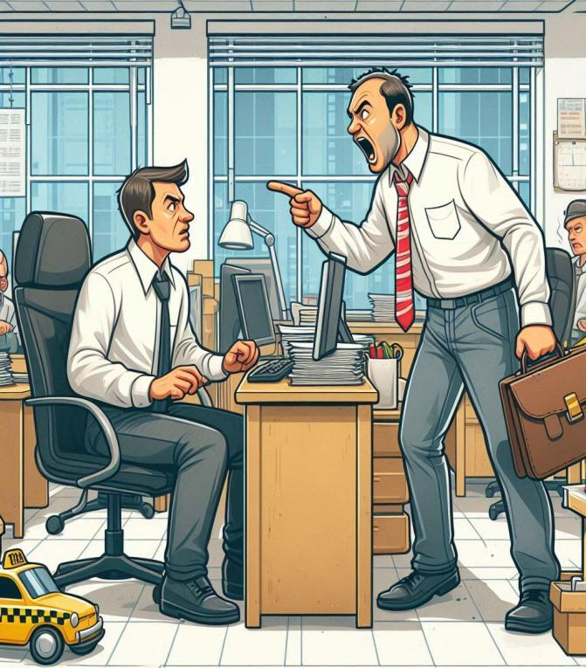
A.R_I18N
He tries to dodge the question by saying, “Well, we had a rough day and we’re exhausted. So, we hit the sack and couldn’t check your calls.” He adds, “I need the address for the fare.” Then Sophie gives the address and player gets the control.
Here, the player has a choice:
1) Either he can reach the destination on time (or)
2) Make the customer wait until he’s fed up of waiting and cancels the ride.
(failing the mission.)

Slide 43
A.R_I18N
00054
To confirm whether he reached the destination, The protago honks which catches the client’s attention and makes it easy to find him. The customer turns out to be a newly-wed desk clerk who’s having a rough sail with his wife.
The player needs to make sure he drives the car with utmost safety by doing anything it takes. Meanwhile, in the backseat, the furious clerk talks to his wife over the phone, “What the fuck is wrong with you?! Why did you do it?”, while the protago feels confused as of on what he should focus on: driving or listening.
While he’s talking over the phone, the protago asks the clerk, “Where shall we go now, sir?”. He complains, “What shall I do with a wife like her?”. As the protago answers, “Maybe love her to the fullest. Sir?”, the clerk turns to the phone and talks to his wife.

Slide 44
A.R_I18N
00054
The player gets the control now and can:
1) Drop the client at his destination on time (or)
2) Drop him late.
If the player drops him on time, he’ll get the required amount of money for the fare. If that doesn’t happen, he gets paid less for taking him late to the destination. So, based on this, the player either gets a good or a bad rating on “CUSTOMER SATISFACTION” tab.
After the player drops off the clerk at the destination, he gets another call from Sophie about the next errand. This time it is a corpo woman who requires his services. As the player reaches the destination, A beautiful woman, dressed in a business suit like a true professional, asks the protago to drive her to her office, pronto without harming “the people”.
(To not hit the pedestrians and drive properly.)

Slide 45
A.R_I18N
00054
The player gets a choice here whether he can ask the client about the kind of work she does and tries to flirt, asking, “What do you do, ma’am?”, however, she dodges the bullet in a professional manner, “That’s on a need-to-know basis. And from where you stand, that’s none of your business. Now fucking drive!”. As the protago feels rude about her reply, he plays music on the radio to distract himself from those words.
After they reach the destination, the woman gets out of the car, drops 5 creds for the errand with a “bonus” for his curiosity about their lifestyle that he never can achieve. As she leaves, the player glances at the humongous skyscrapers, standing as tall as the horizon, and wonders, “Name your lifestyle, but everything comes at a price.” The player gets to roam around and explore new places as he has no errands to run for. While exploring the city, the player can go for a few side quests to make a name for himself in the city.

Slide 46
A.R_I18N
00054
Some time later, the protago gets a call from Vasily. “Hey, Mike. I need you.” The protago asks, “Something wrong?”. Vasily speaks in a whispering tone, “Just come to this place. ASAP.”
The protago checks the location and was stunned for a moment. He asks him, “The fuck, Vasily? That area’s off”.Then Vasily tells, “I know right, don’t I?”. Then the protago asks, “what are you upto? What’s going on really?”. Then Vasily tells him, “There’s some STUFF. We can use to mint some paper for ourselves.” The protago asks sarcastically, “Oh yeah, and how you---”
Then Vasily interrupts saying, “I know it too. But here’s the CATCH. The entire federals are all over the bombing yesterday, believing that the scavengers are tryna make a mess ‘AGAIN’”. The protago continues, “Even that’s the case, we require to ‘A WHOLE LOT OF NEED TO KNOW’ basics ‘bout that area.”

Slide 47
A.R_I18N
00054
Then Vasily replies, “I know it, and I have it. Listen, Mike, This, this is the one. That “ONE”, we talked about it. So please, for god’s sake, have some faith in me. Just come here. Got everything set up for this gig. So What you say?”. The protago sighs, and tells, “We talked about this, but I know you’re gonna do it without me. I’m coming. But just for sightseeing this ‘ONE’ and the ‘PLAN’.”
The protago continues, “Not now. And just to remind you, Sophie called and asked me about you not responding to her. What the hell is that?” Vasily gets confused, and stammers, “Oh. That, umm…. I’ll explain. Just come here, OK?”. The protago replies, “OK.”

Slide 48
A.R_I18N
00054
Now, the player can opt to go directly to the location (or) explore the city.
The quest starts as the player gets to the location.
[cutscene starts]
As the player reaches the location given by Vasily, the protago waits for a few moments. As he arrives/enters the car, “So glad of you to come.” Vasily is delighted that the protago shows up. The protago says, “Yeah. So, what do we know about the place?” Then Vasily states, “I peeked around the place. Couldn’t find many entry points while the guards are patrolling. Here, use this.”
Vasily gives the protago a pair of black sunglasses. As he puts it on, he hears a familiar voice. “Hey, Mike. How are you?” , “Rick?”, says the protago with surprise. “Thought you would be in this.” Rick speaks sarcastically, “You thought that your bulky guy has a plan to sneak into the most secure research facility in the city?”

Slide 49
A.R_I18N
00054
The protago says, “No, but I thought this was his idea all along. So, what do you think?”
[in background] Vasily says, “You’re goddamn right.”
The protago wants to know more about the facility. Rick explains, “That’s a highly secure system with soldiers of the National Guard protecting along with Military-grade turrets and IR cameras watching the facility 24/7.”
Vasily doubts, “So, you are saying it’s not possible?”
Rick says, “Yeah, unless you act like 3rd grade chums. Mike, use your glasses to find the nearest power station. Your shades can triangulate it. So, you don’t need to stress on it.

Slide 50
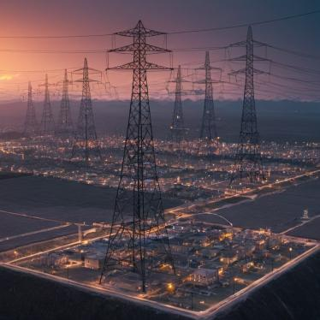
A.R_I18N
00054
The player using the shades must follow the lines (underground) leading them to the main grid. While on their way, the protago says, “Yes, it’s the National Guard; this might be more difficult than we know.”
“But it’s worth the risk, Mike.” “You know, Rick always has a plan---”, assures Vasily.
The protago tells, “Man, these guys are everywhere. So, we gotta watch while driving.”
Rick continues, “Well, unless you think it’s a rally road, don’t bounce all around and drive safely.”

Slide 51
A.R_I18N
00054
The protago interrupts, “Yeah. But this is the national guard. Even if we get in, getting out’s the real deal.”
Vasily says, “yeah. That’s why we’re bringing him. You know.”
The protago asks, “Tosh?” and he sighs. “I thought he’s on retirement. You sure he’s in?”
“Rick got him covered, there is a place we can meet after we find this grid.”
The player needs to find the wire lines which will lead him into the grid.
[P.S. If the player finds the grid before the mission starts; the player can go directly to the grid rather than following the wire lines underground.]

Slide 52
A.R_I18N
00054
After finding the grid the player can call Rick for info about the grid.
“We found it. Less guarded, but it’s huge. Might take out half of this side.”, the protago says.
Rick: “Good. Vas, why don’t you go around and sweep around the place if you can?”
Vasily: “Copy.”
Him and the protago gets out of the car and Vasily scouts the grid, while the protago surveilles the nearby alleys.
Protago “Rick, tell me why Tosh’s taking part in this.” “Yeah. He asked. You know the deal. Everyone needs money in this goddamn mess of a city.” Rick explains,
Protago : (sighing) “ Yeah. I know; the surroundings are mostly barren, as expected.”
Rick: “Once Vas comes back, we’ll rendezvous at the location.”

Slide 53
A.R_I18N
00054
Rick cuts the call and the player has some time to check the surroundings, exploring the outside of the grid, surveying for any unwanted visitors until Vasily comes (or) the player can sit in his car and kill time until he comes.
After some time, Vasily shows up with info about the grid. They both must go to the location sent by Rick to continue the preparation for the Heist codenamed “Blumehouse”.
The player gets control and can choose whether to go to the location with Vasily or by himself.
[As the player reaches the location given by RICK]
It is a house located in the north-western part of the city where the destitute are the lawmakers. If the player goes by himself, Vasily waits outside the door. They both go inside the house which is two-storied. Rick waits in his room in the ground floor.

Slide 54
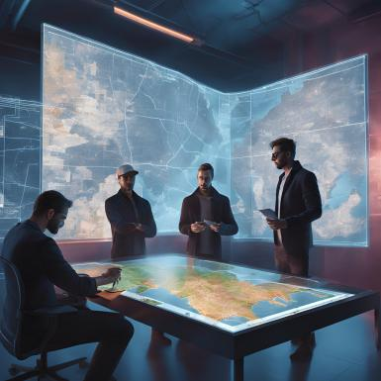
00054
The player has a chance to explore his house and find collectibles if interested regarding Rick. As the protago gets inside the room, Tosh waits with Rick and Vasily in the room. As they enter the room, Rick blinds the room with the controls using his specialized keyboard.

Slide 55
00054
Protago: “Tosh. It’s been, what, seven months? How you’ve been?” As they try to go for a handshake, Vasily interrupts and hugs Tosh, “my Брат(Brother in Russian)! Haven’t changed much, did you?” “I know, Vas. I know. Mike, Good to see you too. I thought the Jewelry Heist was the last one for us.” As Tosh is explaining, the protago interrupts, “Yeah, I know. But here we are.”
(in a comforting tone.)

Slide 56
A.R_I18N
00054
The protago continues, “Anyways, How’s my ‘princess’ doing? Last time I heard, she was ruling her class. Vasily tells, “Ya, how’s my Сестра (Sister in Russian) and little ‘Yumi’ doing?”
Tosh: “They’re, They’re good. Yumi’s ,Yumi’s studying well and ‘Cathy’ too. She had an accident a few months back. Yeah. That’s ---” “ I need this money, Mike. For that I need you guys help. I know I PROMISED that I’ll never come back—”
The protago enters, “We owe you a lot, man. There’s nothing to worry.” Vasily continues, “My brother, take it easy. We comrades always watch each other’s backs.”

Slide 57
00054
Rick interrupts, “I think if you ladies are done yapping, we need to sit for the next heist.” The protago asks in a serious tone, “So, Tosh, what have you got?” Tosh speaks, “The intel that you guys provided gives us a clear picture, whatever that’s inside, the guard doesn’t want us to know.” Vasily adds, “Well, from the outside, it’s a fucking suite for the rich assholes who rot in money.” Rick adds, “So, the base is beneath the suite. It holds something that we need.”
A hologram pops up on the table. As Rick explains, “ The Suite’s a goddamn coverup. It holds access to an underground facility which is guarded by the National Guard. The recent explosion got them stirred and they’re double shifting everything, and the suite is one of them. So,
Getting in needs two things:
1) The Disguise (preferably NG) (or) A guest for the Suite
2) An Access card to the elevator.

Slide 58
00054
Tosh continues, “National Guards are a menace. These guys are the most advanced Combat force ever deployed in this country, taking them on is a suicide for sure.
”( A hologram pops up on the table showing the Outfit)
The protago raises a doubt, “Then how the fuck are we beating them?” Tosh continues, “It’s merely impenetrable. It might even take 4 incendiary slugs just to break it but, everything has a weakness. In this case, it’s the metallic fluid present in the suit near the neck and around legs and arms. One perfect shot and they’re ‘Out of Business’”
Rick speaks, “ here Catch it, hero.”
The protago catches an advanced pistol. “What the hell’s this? You know I don’t do guns.” rick explains “Well, hero, this gun shoots non-lethal and has advanced aim assist. So, Load, aim and BANG! and anyone hit gets smacked down by an angry gorilla.”

Slide 59
A.R_I18N
00054
The protago inspects the gun, while Vasily asks, “What about the perimeter? These мудак (A-hole in Russian) are all over the place.” Tosh continues, “That’s where you come in. The grid that you guys checked out controls power in the eastern part of the city. Let’s say something happens to it, a blackout, perhaps, shall do the trick.”
The protago interrupts, “Let’s say they thought of that. How many they gonna send on that? Maybe half? Then, what about the rest?”
Rick adds, “Well, mike, you’re finally using your head.” The protago grunts. Rick continues “The convoy’s full of toys and supplies for these idiots.
[Map of the convoy route pops up]
“We get its route and tip off our “Scavenger” mates as they are eagerly waiting for a chance to get supplies and they won’t go down without a fight.”

Slide 60
A.R_I18N
00054
“So, what do you think, ladies? You in?”
Tosh continues, “I know this isn’t a foolproof plan, but it’s the only way to get in, if we do this right.”
Vasily asks, “So, how are getting our hands on that EMP for the blackout?”
Tosh tells, “I’ve got a friend. Mike, I need you on this. Get to the location. I’ll tell the details later”
The protago asks, “How do we tip the Scavs off?”
Rick joins, “Vas’ll take care of them. Don’t you, Vasily?”
Vasily nods his head and “Yeah. I guess we don’t have a choice. do we?” “I think you should lend him a hand, Mike.”, says Rick. The protago sighs, “Let’s hope everything goes as planned.” Tosh replies, “it will, Mike. It will…”
(Player gets the control from here)

Slide 61
A.R_I18N
00054
The player can choose to either explore the city with the addition of new side quests as it takes some time to activate the heist.
After a few hours, the player gets a call from Vasily for meeting him at the scrapyard ASAP. And Tosh sends a message to Mike asking him to come to the club in the center of the city. The player can start any mission of their choice.
If the player starts Tosh’s mission first, Tosh waits outside the club which is run by the “Delgado” Family.
The protago asks, “Toshi, what’s the play?”
Toshi tells, “Follow me, and no reflexes. OK?”

Slide 62
A.R_I18N
00054
In the morning, the bar is filled with crooks and dacoits, who work there. If the player goes to the club at night, the club hosts a party with high security at the entry.
(The player needs to choose the time to start the mission depending on their situation)
Tosh hands a card to one of the crooks. After the card gets scanned, He escorts both of them into the bar where the boss, Daniel “Borbon” Delgado, is seated and talks to his associates.
[Night time] Daniel enjoys with his wife and sends her off after seeing Tosh and the protago
[Morning time] Daniel and his goons are checking out the bar’s equipment (guns, ammo, melee weapons)

Slide 63
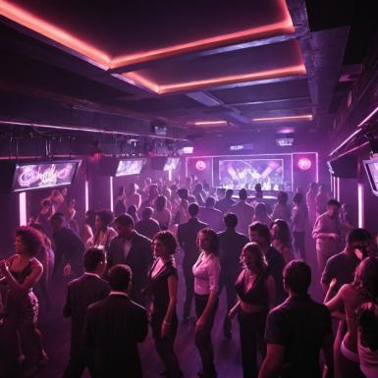
00054
[in any case] After seeing Tosh, Daniel goes towards him. “Hey, Toshiba! It’s been an honor seeing you at my bar.” He shakes his hand with Tosh with a grin on his face.
“Yeah, Daniel. How you doing?” Tosh says, “Fine.” Delgado points his gun towards the protago’s head and asks TOSH, “Who’s this meat-head with you, in my room?”

Slide 64
00054
The protago gets scared from inside, but answers like a brave man, “Name’s Mike. A friend of Tosh.” Daniel looks at Tosh as he nods. Delgado puts his gun down.
Delgado asks, “So, Tosh? To what do I owe this visit?”. He’s tensed from the inside but tries to stay calm. Tosh asks, “I need an EMP bomb, Danny. Know where I can find one?” Daniel tries to hide his laughter.
[Night time] Delgado offers a seat to Tosh & the protago while he sends his wife away.

Slide 65
A.R_I18N
00054
After sitting, the protago asks, “Mr. Delgado, as my friend was asking---”
Delgado interrupts with a grunt, “Y’know, this man saved my life twice, no questions asked and now you’ve come with him for an EMP bomb? May I know why do you need one?”
Tosh explains, “Personal Vendetta, That’s why I need it.”
Delgado bursts into laughter sarcastically, “Personal Vendetta? For Yoshimitsu Toshiba? Ex-CyberNinja?”
“Fine. Fine.” He orders the goon, “consigue la caja” (Get the box in Spanish)

Slide 66
A.R_I18N
00054
The goon puts the box on the table and opens it. Inside is an EMP device. “This is one of a kind. Anything under its radar fries like a potato.” , explains Delgado. The protago asks, “Hmm. So how did you get your hands on this?” Tosh assures, “Maybe I’ll tell another time, Mike.” He faces Delgado and asks, “Can I have a couple of ‘em?”
[Daniel’s men look a bit triggered]
Delgado bargains, “It’ll cost you quite a bit, Tosh.” “Name your price, Danny.”, says Tosh. “No idea what were you up to, but I need a cut. Y’know, for the boys.”
The player has the choice whether to accept or refuse the deal.

Slide 67
A.R_I18N
00054
[refusal] Danny’s pissed as hell and orders his men to hunt them down and yells, “Bring their heads to me!!”
[The player will have control]
(Morning time);The player needs to be extra cautious during the crossfires as he doesn’t have implants and couple of shots kills him on the spot. After he deals with them, both Tosh & the protago confront Daniel and can either kill him (or) leave him. However, his men guard the club like a fortress. The protago needs to escape along with him.
After they make their escape, Tosh appreciates, “That’s a good one. Keep up the work, Mike. I’ll plant them along the grid and ring you up.” Tosh gets out of the car and the mission is concluded.

Slide 68
A.R_I18N
00054
[Night time] If the player refuses the deal, Daniel orders his men to go after them and kill them. As there’s a party going on, there are less people but they’re better equipped. The player needs to get out of their club before backup arrives at the scene. If backup arrives, the duo gets overrun and they die. If they escape, Tosh gets his hands on the EMPs concluding the mission.
Daniel calls Tosh and tries to intimidate him, “The deal’s still on, until you wish for death.”
If the player finds Daniel During the shootout and incapacitates him, He calls his men off and lets player and Tosh walk away alive without the deal.
If the player accepts the deal, Tosh takes the EMPs while Delgado and the protago shake hands and they get out of the club without a scratch. After getting out, Tosh says, “You changed, Mike. For better (or) worse. We got the EMPs. I’ll plant them along the grid and ring you up.”, which completes the mission.

Slide 69
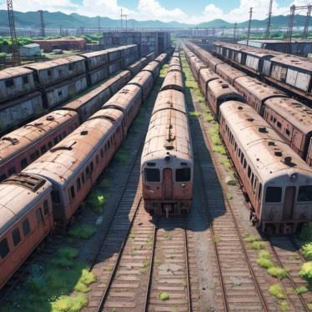
00054
The protago goes to the trainyard where Vasily is waiting along the sides, recalling his old times in his country. As the player approaches Vasily tells the protago, “You know, мой папаша(my dad in Russian) used to drive these. Mike sighs, “Yeah. told me .” Vasily asks with surprise, “What? When?”. The protago reminds, “The other day, when you’re drunk like there’s no tomorrow.”

Slide 70
00054
“Huh, well… Those scavs want us to meet about the convoy’s location.” Vasily conforms; The protago asks, “Outside? You sure it’s safe? Cuz it’s their turf.” Vasily replies, “Yeah, their turf, their rules. That’s what they told.” The protago worried, “guess we don’t have a choice. Do we?”
The protago looks a bit concerned but accepts reluctantly. So, the duo goes to the location where the convoy arrives.
(The mission progresses in morning even if the player starts it at night.)

Slide 71
A.R_I18N
00054
As they arrive at the place, The scavs are waiting for them. Sam, their boss, asks. “Out of the car. Now!” while the rest point their guns at them. They get out of the car with their hands in the air to avoid suspicion.
Vasily states, “We came as you asked. Time to get into biz.” Sam speaks in a cold tone, “You wanna do business chum? What have you got for me?” Vasily tries to take a shard out of his pocket. However, Sam stops him and asks one of his men to get it. Vasily assures, “It’s in my pocket, brother. Be gentle.”
The guy gets the shard from Vasily and gives it to Sam. He inserts the slot and scans it. Sam points to the protago and asks, “You, Human! What’s your plan?”

Slide 72
A.R_I18N
00054
He replies, “So, the convoy heads to the suite tomorrow. It has a lot of toys and supplies that you desperately need. So, consider it a help.”
Sam takes out his gun and points it on the protago’s chest. He questions, “So, you want me to go on a faceoff with those fuckers and steal their stuff?” Sam points the gun at the protago and tries to intimidate him saying, “You take me for a fool now, huh?”
Then Vasily asks, “But you’re framed for the bomb blast at the border, right?”. The protago adds, “They enjoy fine meals at the suite while you get shot like ducks in a lake? I say, this convoy might help you more than it’ll help us.” “Don’t worry, we’ll signal you guys to attack. Just have some faith in us,”

Slide 73
A.R_I18N
00054
Sam says, “Hmm, this human speaks. Let’s hope that works, for yours’s sake.”
Vasily cheers them up saying, “The deal’s done. Time to put them into the ground.” Sam lets the duo go and gets back to his place with the crew.
The protago gets inside the car and asks Vasily, “You coming?” Vasily replies, “Well, me and Tosh gotta get the outfit for the heist.”
“You, my friend, did well today. So, rest up. I’ll ring you.”
Vasily gets into Tosh’s car and goes off, completing the mission and preparation for the heist.
P.S.:- If player chooses to do Vasily’s mission first, he informs the player to complete the errand for Tosh[ Tosh’s mission] quickly so that they can start the heist. Same goes for Tosh as well.
After completing both the missions the player needs to wait for some time for the Heist setup.
Rick calls the player to meet him at the GRAND TERMINAL station where they’ll start the heist. The player can start the mission at their will as it starts as soon as he reaches the station.

Slide 74
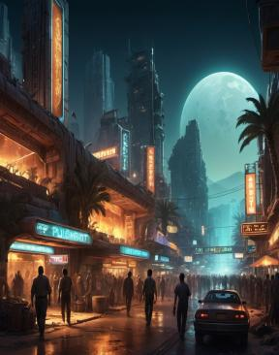
A.R_I18N
00054
As he reaches the terminal, the player gets a message from Rick stating that he’s waiting at Terminal C.
The player needs to navigate through the terminals and meet Rick who is sitting on one of the benches.
[Cutscene starts]
As the protago sits beside Rick, He tells, “Look straight. No suspicion to be aroused. So,---”
The protago tells, “I know, Rick. What do you want to do with me at a place like this?”
Rick says, “Grab this ticket. Time to head to the Borderlands and pick up Tosh.” The protago asks with a surprising look on his face, “What’s Tosh doing here? He’s supposed to be on the other side, at the grid.”

Slide 75
00054
Rick gets frustrated but controls himself and tells, “This looks like a questionnaire. I don’t have time for this. Just get there. Tosh will brief you up, and, I need your car keys.”
The protago asks, “What? My Car keys? May I ask why?”
Rick replies, “Need to buff the ride up. And don’t worry, I’ll not mess with the ride. OK?”
The protago sighs and tells reluctantly, “Fine. Where shall I drop ‘em?” Rick replies, “The barrel behind you. I’ll take them. You need to board the train.” “And Mike, just like old times, yeah?”
[The train arrives on the platform]
The protago says with annoyance on his face, “But never like this.”
The player puts the car keys in the barrel and gets on the train. After getting in, Rick says, “It’ll be our MAGNUM OPUS, Mike. Time to go down in history.” and disconnects the call. The protago utters to himself, “Now, where did I hear this?”

Slide 76
A.R_I18N
00054
After some moments pass, the protago informs Sophie through Voicemail, “Hey, Sophie. Uh, I’ll be taking off today. Don’t worry. It’s nothing serious. Me and Vas wanted a break for ourselves. So, we’ll be back in no time. Take care.”
After travelling some distance, an announcement rings inside the train. “Next stop. Borderlands.” The protago gets nervous and tries to calm down, “It’s gonna be alright. Stay calm.” He looks at his watch and rolls down his sleeve.
After a few moments, the train comes to a stop at the Borderlands’ grand station.
[Player gets control]
The protago walks out of the train and as he proceeds towards the exit. A couple of men halt him asking, “Are you Mike?” The protago replies, “Yes.” while one of the guys scans him without his knowledge.

Slide 77
A.R_I18N
00054
He hands the keys to the protago saying, “Have a nice ride, Sir. The car’s outside. Waiting”
As the player gets to the car, which has armored body and tires, with a new engine and Nitro as a bonus, he gets excited and as he enters the car, he calls Rick and tells, “Rick, you bastard. This is fucking amazing! Thanks a lot, man.”
Rick replies, “I know, right? Now go get Tosh. The convoy’s moving.” The protago revs the car and says, “Let’s fucking go!” The player needs to go to pickup Tosh from the nearby substation. As Tosh enters the protago’s car, he asks, “All set?”. Tosh replies, “Yup.”

Slide 78
00054
(P.S.:- If the protago takes his time cruising around the city rather than doing the mission, Rick calls and says, “ We missed it. It’s done. Well, as of you, you’re a certified turd HAVE A NICE DAY!.” (and the mission fails)
The player needs to park closer to the suite and should wait patiently. Tosh is getting ready at the back of the car and gives the player a trigger button. The player needs to press it to trigger a blackout by activating the EMPs.
They get out of the car and wait for their second signal. A few moments pass and the player was about to call Rick, and one of the guards comes over. He tells, “Convoy’s under attack midway. We need to go, Now!!” The other guard questioned, “Then, what about the blackout?” “Don’t worry. It’s an EMP, but a big one. The backup generators will activate within 7 minutes. That’s enough for us.”

Slide 79
00054
The duo set a timer from 6:27 from now and the clock ticks. The protago asks, “So, where is Vas? He looks like a weirdo in the National Guard outfit. Tosh tells, “No. We don’t have it” The protago asks in a serious manner, “Then how the fuck are we getting in?” As Tosh takes the protago to the main entrance, Tosh says, “Don’t worry, Mike.” Vasily shows up, interrupting, “Everything is planned my friend.”
All of them enter the suite which is spacious but dark because of the blackout. Tosh speaks, “Vas, where’s the terminal? Clock’s ticking.” Vasily escorts them to the terminal as Tosh puts a hacking charge on it. Vasily assures the protago, “It’s alright.” The terminal gets hacked and the elevator opens which leads to the secret area underground.

Slide 80
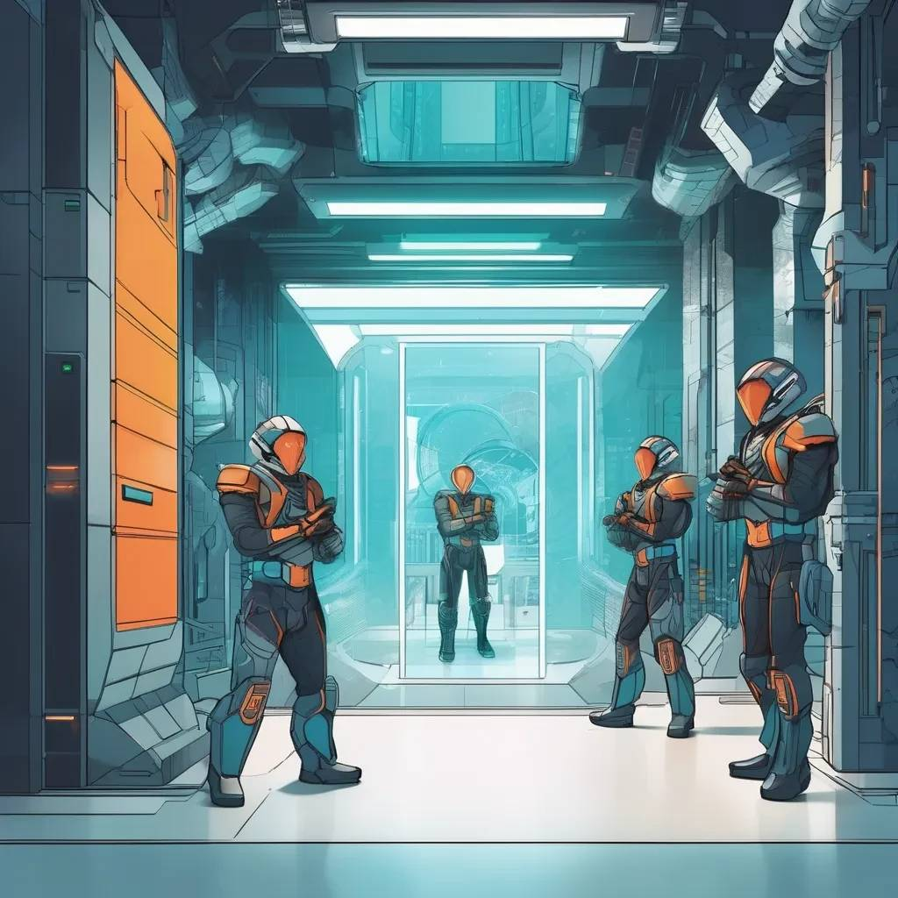
00054
Vasily stays behind to keep the cover while Tosh and the player get inside. As they get down, Tosh says, “There’s a security panel down there. I’ll disable it once we get there.” The cameras are running on reserve power and the guards working there use their Night Vision. So, Mike, until I disable them, stay like a ghost and no one should see you. If it happens, we’re good as dead. Got it?”
The protago says, “Yeah. Got it.” As the elevator gets down, Tosh tells, “Time to do this.” Tosh goes to find the Security panel and the player needs to use the shades to make sure he doesn’t get caught. Tosh disables the Security after some time and player can start shooting their way towards the control room.

Slide 81
A.R_I18N
00054
As they’re going, Vas comes hurriedly down the elevator and says, “Our Scav friends went dark. The guards can come back anytime.” Tosh, with tension, says, “Fuck!”. He tells Vasily, “Check every room. Find Mike and get into the control room. I’ll deal with any un-invited company along this way.” The player gets inside the control room where he finds 3 scientists trying to shut down something. The protago orders, “ Put your damn hands in the air unless you want a bullet in your fucking head!!”
As 2 of them go to the other side while the 3rd jumps on the protago, throwing his gun away and tries to stab him with a syringe. The player gets a Quick Time Event(Q.T.E),where he needs to mash buttons so he can’t get stabbed, thereby stalling time. The other two get out, while Vas enters and shoots the 3rd scientist with the protago’s gun and incapacitates him. Vasily gives the gun back to the protago, saying, “You lost something.” The protago tells, “Thanks.”

Slide 82
A.R_I18N
00054
Now, Vasily goes to the scientist and asks, “Where’s the STUFF that you’re protecting? Huh?” The scientist struggles. Vas orders the protago, “Check their systems .” The player uses their controls to find anything that’s valuable. Vasily grows impatient, takes his gun and intimidates the scientist. As the player finds a Giant glass container, the scientist mutters pointing towards the container, “Project! Project—” and he dies while he was about to answer.
Vasily becomes enraged and goes through a temper tantrum, while the player needs to take the glassed container to the nearby elevator where Tosh waits.
As the player tries to calm down Vasily, the facility goes into lockdown and the player tries to stop it. The entire facility gets filled with gas causing the player to disorient and fall on the floor. The protago struggles to breathe…

Slide 83
00054
The player needs to crawl towards the exit to escape while the gas is disorienting him. As the protago is going into an unconscious state, Vasily arrives towards the protago “THIS IS NOT THE TIME to die, MY Брат.”
Vasily lifts the protago up and holds him on himself and drags him towards the elevator, on their way the protago sees the dead scientists. Seeing them, the protago tries to ask Vasily (in a struggling tone), “Wwh – Why?”
Vasily, “Shut. The. fuck. Up.” (the protago hears it in a mumbling tone)
Tosh comes and both of them carry the protago to the elevator.
Tosh puts the player down beside the container while Vasily tries to inject him with a health boost. But, Tosh stops Vasily and grabs the booster and then an argument ensues with Vasily as those boosters, if taken by a non-implant human, might kill him.

Slide 84
A.R_I18N
00054
Tosh takes the container out and uses a nearby truck, loads it onto the truck while Vasily covers him. Tosh flees from the scene, making an escape. Vasily uses the keys to get the protago’s car around, puts him in the backseat and drives off the place while the National Guard are chasing them.
The protago loses his consciousness slowly, and Vasily uses the booster as his last resort to save his friend. The protago gets conscious even though he’s still disoriented.
[The player gets the control]
The player needs to find the gun and after finding it, leans out of the car and shoots at the National Guard aimlessly. One of the bullets hits the tire of the front car, creating a crash chain, slowing down the force and buys them time to get off the place. The protago passes out and falls down on the backseat.

Slide 85
A.R_I18N
00054
(Some time later…)
The protago wakes up on the couch with a couple of medicines and a glass of water on the table to his right, and a case of beers on the left. The player has the choice to choose either of their interest. Infront of him, Rick, who’s reading a book, “ Norwegian Wood”
Rick says, “You know how long you’ve hit the sack?” The protago replies with a yawn, “Oh. Well, well --- a couple of hours at most. What’s the time?”
Rick, in a surprised, “You fucking muppet! You passed out like a shithead and I would’ve helped a few people by tearing you apart if you didn’t wake up.”
The player has the choice whether to throw a pen in a nearby stand on Rick, or leave it.

Slide 86
00054
Rick turns on the TV. News anchor reports, “Who fell the suite of the City? Reports say that there was a heist that happened in the suite, yesterday.”
[Rick changes the channel]
Another reporter states, “Convoy attacked. Who’s behind this attack? Does it have any connection with the explosion that took place a few days ago?”
[A frustrated Rick changes the channel again]
A male news reporter reports, “Officer Natalie and her team, aka the 3RD division, gets suspended. She and her team are currently facing allegations regarding their role in the explosion in the city.”
[Rick gets real furious and turns off the TV]

Slide 87
A.R_I18N
00054
With an evil expression and giggles, “Looks like we’re famous, ladies. Time to get shit done.” And the protago asks, “How much did we make, you sloppy scumbag?”
Rick answers, “How much? HOW MUCH?!! It’s 5 fucking million, you wanker!” The protago spits while drinking and asks, “The fuck you talking? 5 mil? You sure?”
Rick replies, “You think it’s a joke? Of course it’s a fucking 5!”. He continues, “We’re millionaires, Mikey! We’re filthy rich now!” The protago asks in a happy mood, “What about Vas? And Tosh? Where are they?”
Rick “Tosh went underground” “To his fam.” “And Vas needs yer arse at Sophie’s once you’re prepped up.”
The player gets up, does chores, gets ready, wears a jacket with a logo on it that reads “Avalanche” and rides to Sophie’s.

Slide 88
A.R_I18N
00054
The protago rings the doorbell, and Sophie opens the door. Vas is inside with his shit load and as he sees the protago, he gets up, calls Sophie, and kisses Sophie on her forehead, saying, “See you soon, Love.” The protago says, “I guess THIS IS THE ONE.” Vasily replies, “Yeah. It is.” As Vasily gets the luggage in the backseat, the protago goes to Sophie and comforts her. After he puts the luggage in the car, Vasily says, “I’m ready.” Sophie cries and bids farewell as they drove off their driveway.

Slide 89
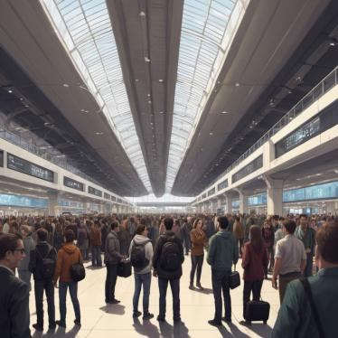
A.R_I18N
00054
The player needs to drive to the airport. While the protago and Vasily have a conversation about their pasts, and what adventures they’ve been through, they reach the airport.
(As they reach the airport)
The protago hugs Vasily tightly, whispering, “ Да пребудут с тобой ветры, брат мой( May the winds be with you, my brother in Russian). Vasily cries for a moment as he’s gonna watch him one last time before he goes to the boarding gate….

Slide 90
A.R_I18N
00054
[The screen blacks out with a pop up ‘A week later’]
The protago grooms himself by trimming his beard, gets a freshup, suits up and gets his keys, goes to the car, gets in, revs it up and does his job as usual.
The player gets the control, while the camera backs off slowly towards the 3rd person view as the player drives the car, the camera shifts towards the city, embracing its beauty, while a soothing tune (Liar by Dawn Jay) plays on the radio.

Slide 91
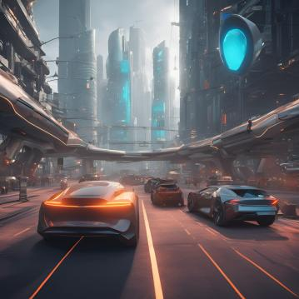
A.R_I18N
00054
The player halts at a traffic signal where the camera shifts slowly. While he’s waiting at the signal, the song fades away slowly with an announcement in the radio.
“I’ve got a flash news, hot as a tamale. You’re listening to Radio Tamale. So, I’ve been wondering a lot about the heist at the suite. Whoever did this must be bathing in money.” The protago turns off the radio, speaking to himself, “Ugh. This again?”.

Slide 92
A.R_I18N
00054
The signal turns green and the player moves the car forward, but a delivery truck with failed brakes hits the car. The scene cuts off 1st time during the hit, 2nd time when the car flips in the air, 3rd time after it lands against the wall with high impact. The protago tries to get out but he can’t as his body completely shatters and passes out…
A Voice whispers in the protago’s ear as he is dying…
“NOT YET. NOT TODAY…”
TO BE CONTINUED

Slide 93
More About Us!!
A.R_I18N
00054
Story by : Rathna Kamal . J
Creative Writer: Rathna Kamal. J
What I know:
Speaking Languages : Hindi, English, Spanish, German, French
Skills : Python, Java, HTML, Unreal Engine 5
Contact : rathnakamaljonnalagadda2004@gmail.com

Slide 94
A.R_I18N
00054
P.S. :- To the glorious team of CD PROJEKT RED, I write this to inform that all the characters, names, locations are purely fictional and any resemblance in real life is purely coincidental.
This story took 2 years of creative writing inspired by the games produced by your company and many others. If there is resemblance found in different titles, they are purely inspirational for us. This story is made with Hard work and Dedication. Please consider this as our CV As I want to work as an intern. Hope your team likes the story.

Slide 95
A.R_I18N
00054
THANK YOU!

